Slide 1
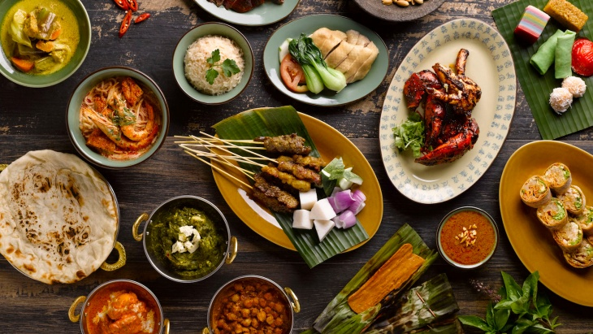
The Battle of the Neighborhoods Finding the best location to open an Indonesian Restaurant in Toronto, Canada
IBM Capstone Project
By Fitria Kurniasari

Slide 2
Introduction
In the early post-world war II period, most migrants from Indonesia to Canada were Indo people of mixed Dutch and original ancestry.
7,610 respondents to the 1991 census stated their place of birth as “Indonesia". Around half of those were settled in the Greater Toronto Area.

Slide 3
Business Problem
Our client want to open Indonesian restaurant in which area. The objectives of this capstone project is to select and analyze the best location in Toronto to open a new restaurant.

Slide 4
Data
List of the neighborhoods in Toronto, Canada.
Latitude and longitude coordinates of those neighborhoods. This is required in order to plot the map.
Venues data, particularly related to Indonesian Restaurants. For this project we will use the Foursquare Places API. One of the features of this API is to provide a list of venues within a specific location, based on the Latitude and longitude coordinates and a radius. The data is used to clustering on the neighborhoods.

Slide 5
Methodology
How to get neighborhood list
Using Beautifulsoup & Geocoder package
Used Foursquare API to get the top 100 venues that are within a radius of 2000 meters
Clustering on the data by using k-means clustering
Using K=8 to get good separation

Slide 6
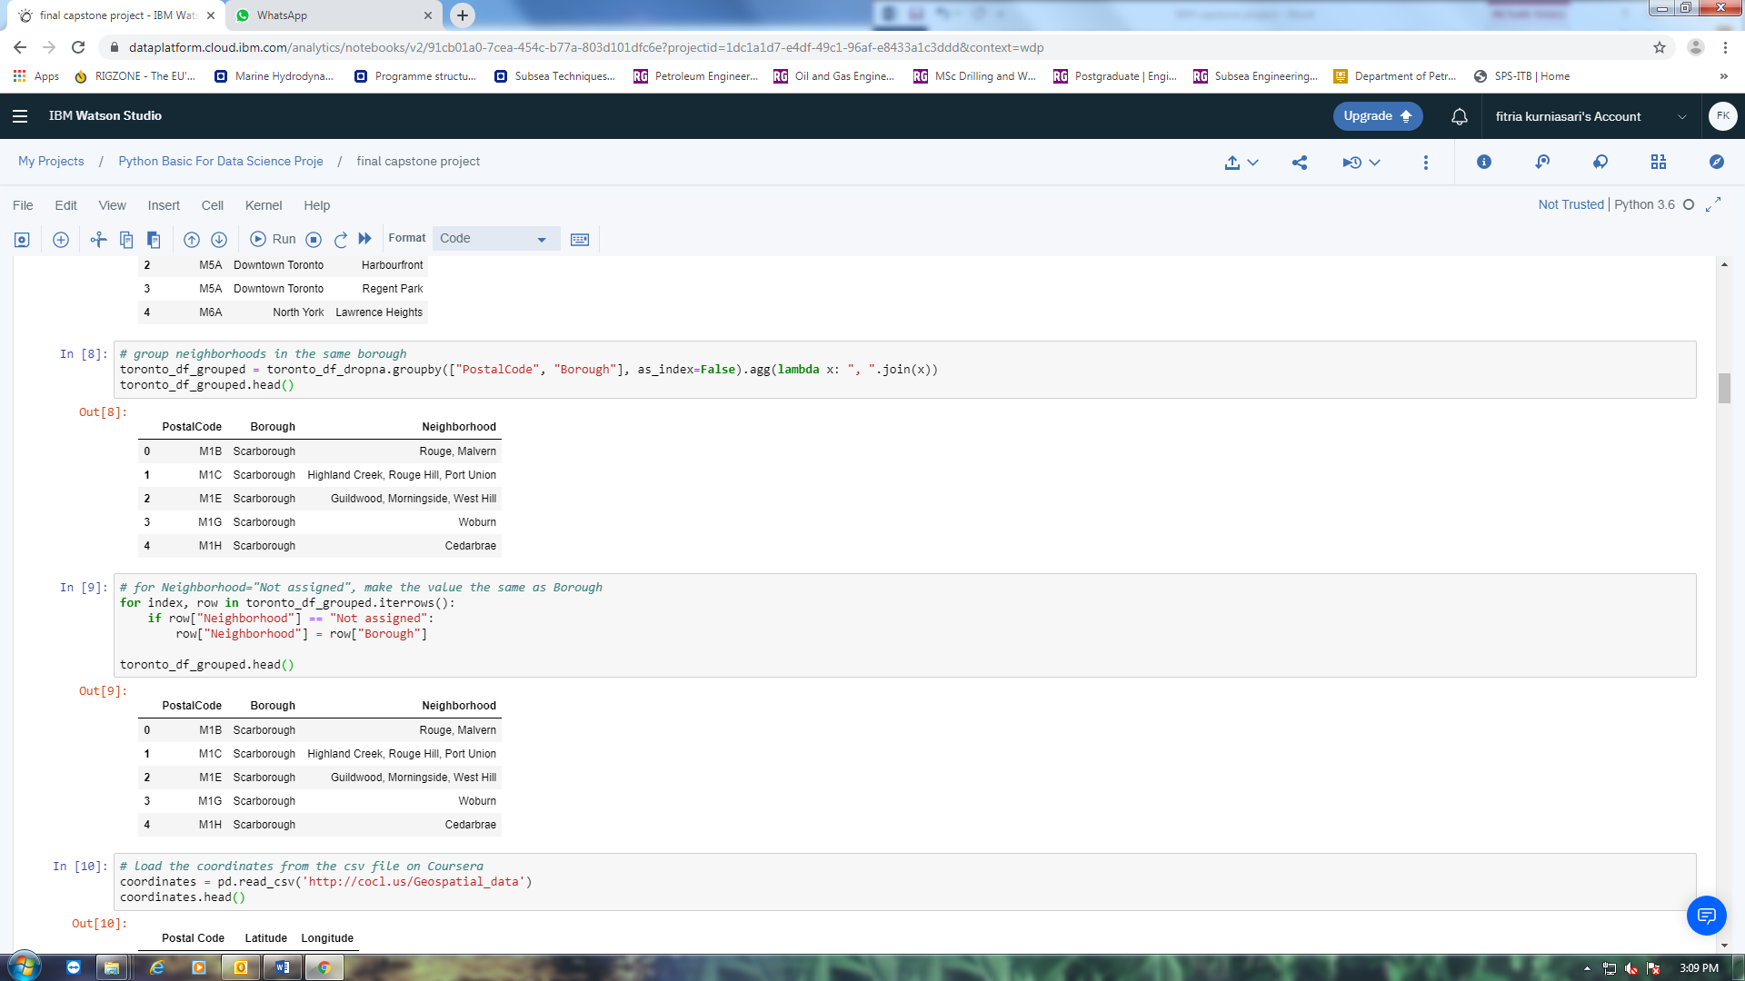
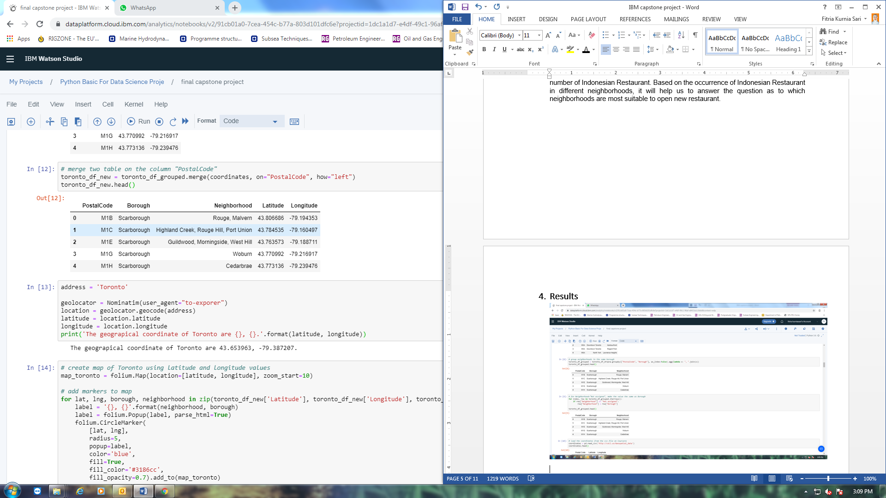
Result
Neighborhood list

Slide 7
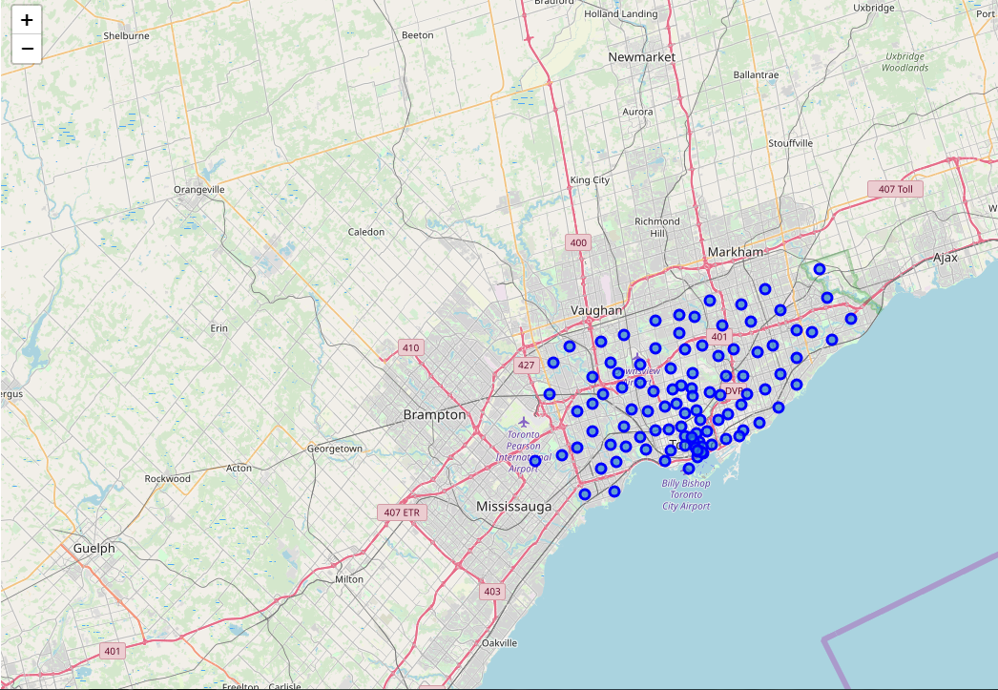
Folium Map of neighborhood

Slide 8
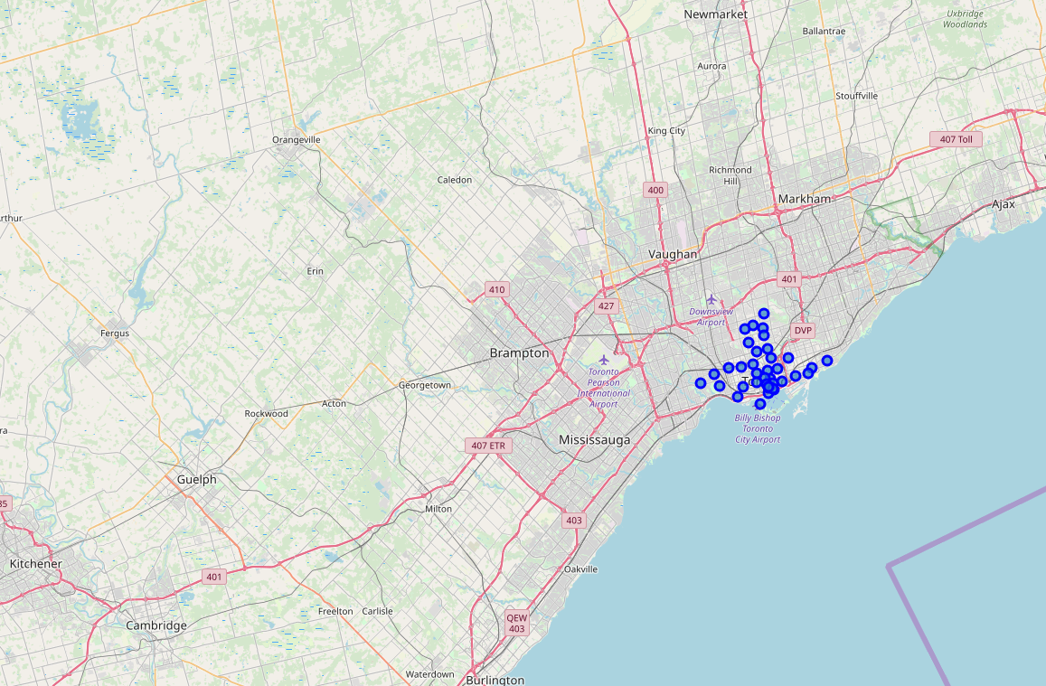
Folium Map of neighborhood with “Toronto” only

Slide 9
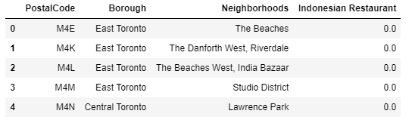
Indonesian Restaurant in neighborhood

Slide 10
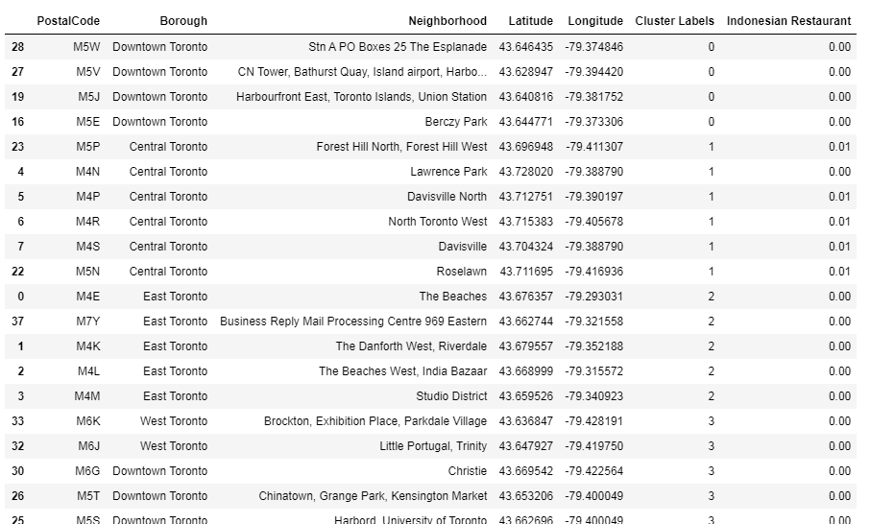

Slide 11
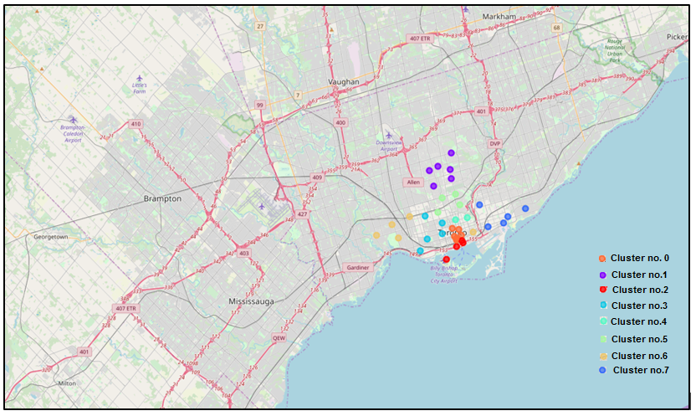
Folium map of clustering

Slide 12
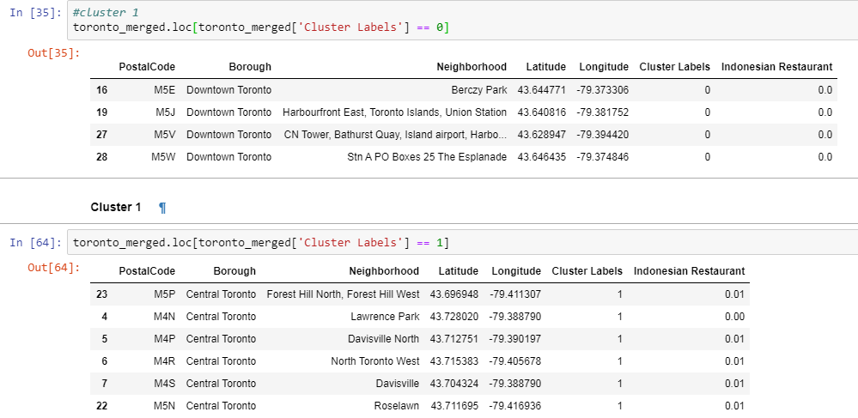
Clustering Result

Slide 13
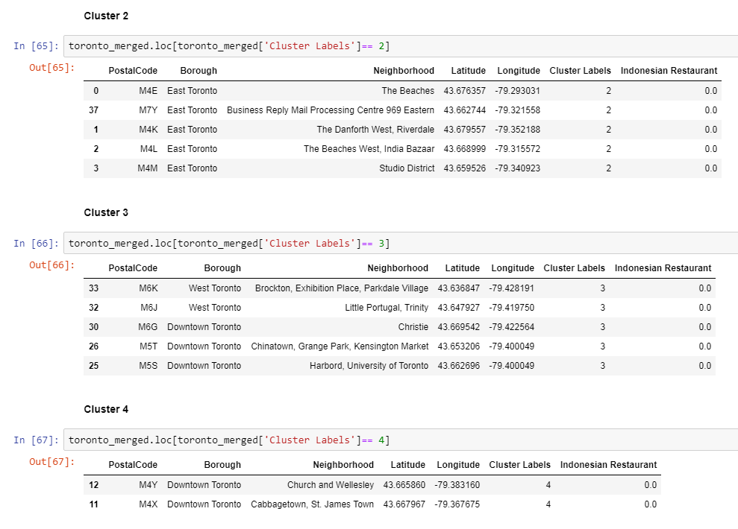

Slide 14
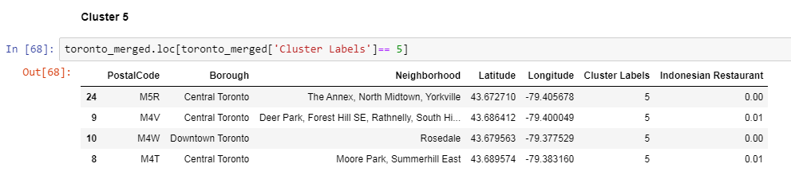

Slide 15
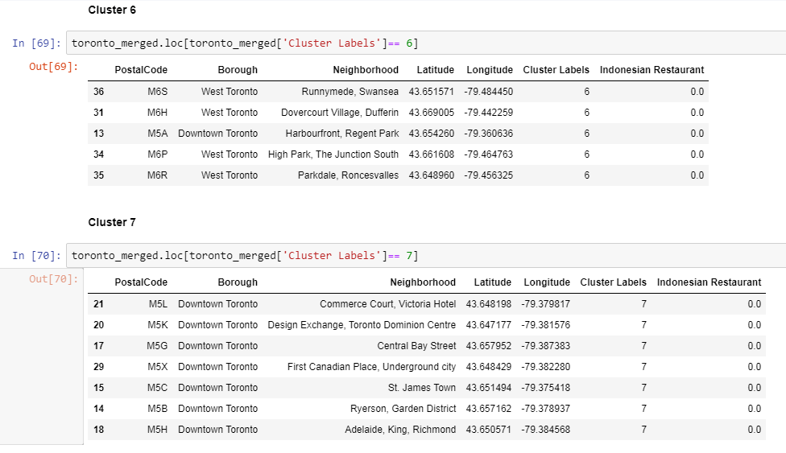

Slide 16
Discussion
This model will be great if there is additional data of numbers Indonesian immigrant in each Toronto neighborhoods and their ethics. So, the model will be more accurate and what type of Indonesian Restaurant can be configure like Javanese, Sundanese, Bataknese, Medan, or Padang Restaurant.

Slide 17
Conclusion
Most of the Indonesian Restaurant are concentrated in the central Toronto, at cluster 1 and cluster 5 with the same number. Almost every neighborhood at cluster 1 has indonesian restaurant, while cluster 5 is only 2 neighborhood. So, it will be great opportunity to open the restaurant in other clusters because it doesn't exist yet. The cluster selected should be not too close to cluster 1 and 5 example cluster no.0, no.2, and no.6, so the businessman should go south area instead of towards the middle area. Lastly, businessman are advised to avoid neighborhoods in cluster 1 and 5 which already have Indonesian Restaurant and suffering from intense competition.

Slide 18
THANK YOU

